Slide 1
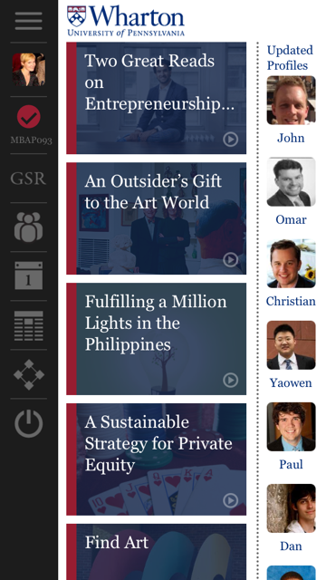
If you haven’t already, download Wharton Connect app from Apple or Google Play or visit http://whr.tn/wh-connect from your mobile device or laptop.
Wharton Connect is used to check-in for these fixed core courses:
MGEC 611, MGEC 612, MKTG 611, STAT 613, STAT 621
Flex core and elective faculty may opt to use Wharton Connect. Consult course syllabus for what is considered a late check-in/absent.
Failure to check-in will result in an automated e-mail being sent to your Wharton e-mail address with detailed instructions on how to resolve the absence.
Reasons for absence include: personal illness, personal or family emergency, religious observance, Wharton Connect app issue, and other.

